Slide 1
The “F” In FOSS
Affording Open Source In Developing Countries

Slide 2



whoami
Ahmed Sobeh
Engineering Manager @ Aiven’s OSPO
Worked with and led diverse teams
Born and raised in a country that tries to be developing
github.com/ahmedsobeh
linkedin.com/ahmedsobeh
twitter.com/ahmedszakaria
@ahmedszakaria

Slide 3
Background
@ahmedszakaria
Notes:
Issues you can’t relate to, struggles you might find trivial and ideas you might think are already everywhere

Slide 4
What is a developing Country?
@ahmedszakaria
Notes:
The term was coined in 1960 by Walt Whitman Rostow, in his classical piece, The Stages of Economic Growth: A Non-Communist Manifesto (1960)

Slide 5
What is a developing Country?
And does it mean now what it meant before?
@ahmedszakaria
Notes:
The term was coined in 1960 by Walt Whitman Rostow, in his classical piece, The Stages of Economic Growth: A Non-Communist Manifesto (1960)

Slide 6
What is a developing country?
Actually developing
And does it mean now what it meant before?
@ahmedszakaria

Slide 7
What is a developing country?
Actually developing
Trying to develop
And does it mean now what it meant before?
@ahmedszakaria

Slide 8
What is a developing country?
Actually developing
Trying to develop
Stagnant - الدول المتخلفة “Left behind”
And does it mean now what it meant before?
@ahmedszakaria

Slide 9
The Current State
@ahmedszakaria

Slide 10
Actual conversation from twitter
Angry Person: They STOLE our work and they’re building new stuff with it!!!
@ahmedszakaria

Slide 11
Actual conversation from twitter
Angry Person: They STOLE our work and they’re building new stuff with it!!!
Random Person: Isn’t that the whole point of open-source?
@ahmedszakaria

Slide 12
Actual conversation from twitter
Angry Person: They STOLE our work and they’re building new stuff with it!!!
Random Person: Isn’t that the whole point of open-source?
Angry Person: Maybe it is but it’s still stealing in my view
@ahmedszakaria

Slide 13
A Question asked at a team meeting
What does Open Source mean to you?
@ahmedszakaria

Slide 14
A Question asked at a team meeting
What does Open Source mean to you?
Answer A: Free Software that I can use without paying
@ahmedszakaria

Slide 15
A Question asked at a team meeting
What does Open Source mean to you?
Answer A: Free Software that I can use without paying
Answer B: I gotta check with IT before I install any of those
@ahmedszakaria

Slide 16
A Question asked at a team meeting
What does Open Source mean to you?
Answer A: Free Software that I can use without paying
Answer B: I gotta check with IT before I install any of those
Answer C: I gotta check with the security team before I use any of those?
@ahmedszakaria

Slide 17
A Question asked at a team meeting
What does Open Source mean to you?
Answer A: Free Software that I can use without paying
Answer B: I gotta check with IT before I install any of those
Answer C: I gotta check with the security team before I use any of those?
My Answer: I don’t have to wait for the next release, I can fix the bug myself locally
@ahmedszakaria
Notes:
None of these answers touch the main essence of open source, sustainability, community collaboration, decentralization or transparency

Slide 18
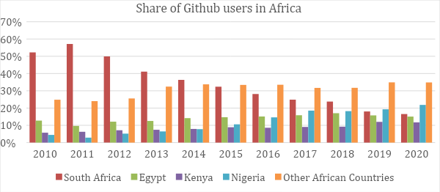
How Is It Right Now?
Africa
@ahmedszakaria
Notes:
https://www.ictworks.org/africans-contribute-open-source-software/#.Y_E5kXaZPao The share of Github users that contribute to open source was dominated by South Africa a decade ago, reaching over 50% in 2011, but this dominance has been challenged by a rapid growth in open source contributions from Kenya and Nigeria. Nigeria became the country with the largest number of contributing Github users in 2019, and held that position in 2020, with South Africa in second place, Egypt in third place, and Kenya in the fourth place.

Slide 19
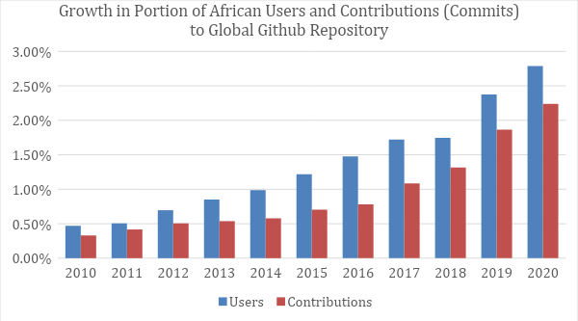
How Is It Right Now?
Africa
@ahmedszakaria
Notes:
https://www.ictworks.org/africans-contribute-open-source-software/#.Y_E5kXaZPao We analysed general trends of open source contributions from African users between 2010 and 2020 and discovered that there has been a general increase in the share of contributing Github authors in Africa, from just under 0.5% in 2010 to approximately 2.7% in 2020. The share of actual total contributions from African authors similarly grew from 0.3% in 2010 to approximately 2.3% in 2020.

Slide 20
Why should we care?
@ahmedszakaria
Notes:
Open source software can provide a low-cost alternative to proprietary software, enabling more people to participate in the digital economy. This, in turn, can help to close the digital divide and promote economic development. Also promotes digital literacy, skills development. Transparency would also build local trust and innovation. And solve local problems

Slide 21
Why Should We Care?
Top 10 countries to outsource software development to
India | Ukraine
China | Poland
The Philippines | Romania
Brazil | Taiwan
Egypt | Canada
@ahmedszakaria

Slide 22
Challenges
@ahmedszakaria

Slide 23
Challenges deep-dive
Society and Culture
@ahmedszakaria

Slide 24
Challenges deep-dive
Resources and Infrastructure
Society and Culture
@ahmedszakaria

Slide 25
Challenges deep-dive
Resources and Infrastructure
Governance
Society and Culture
@ahmedszakaria

Slide 26
Society and Culture
@ahmedszakaria

Slide 27
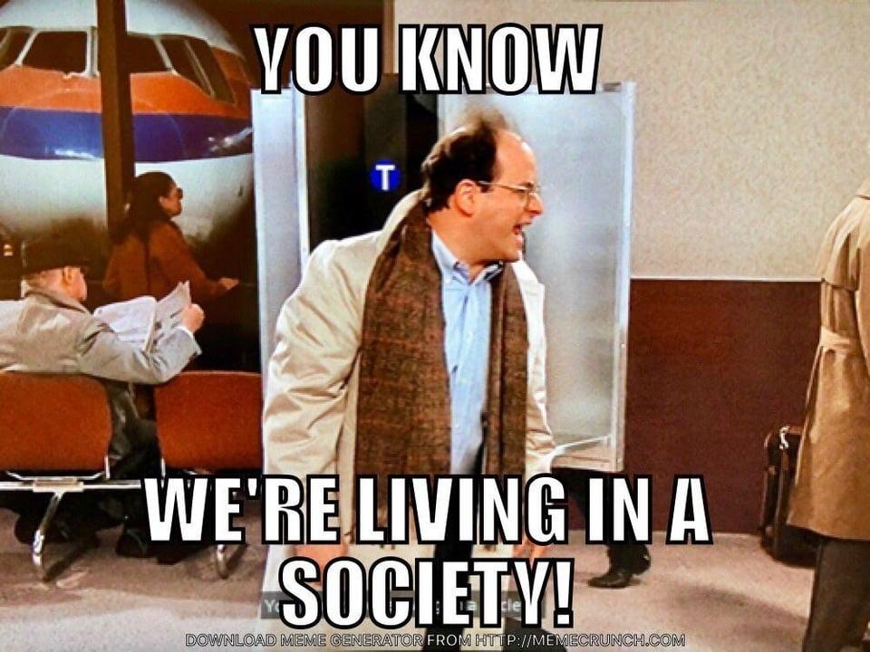
@ahmedszakaria

Slide 28
Open Source Culture
Open and transparent
@ahmedszakaria

Slide 29
Open Source Culture
Open and transparent
Information should be as freely and publicly accessible as possible
@ahmedszakaria

Slide 30
Open Source Culture
Open and transparent
Free
Information should be as freely and publicly accessible as possible
@ahmedszakaria

Slide 31
Open Source Culture
Open and transparent
Free
Information should be as freely and publicly accessible as possible
Distributed modes of collaboration, in which large groups of people work together without a strongly centralized authority directing them, are highly effective
@ahmedszakaria

Slide 32
Open Source Culture
Open and transparent
Free
Dynamic
Information should be as freely and publicly accessible as possible
Distributed modes of collaboration, in which large groups of people work together without a strongly centralized authority directing them, are highly effective
@ahmedszakaria

Slide 33
Open Source Culture
Open and transparent
Free
Dynamic
Information should be as freely and publicly accessible as possible
Distributed modes of collaboration, in which large groups of people work together without a strongly centralized authority directing them, are highly effective
Being resistant to change and preferring to stick with traditional approaches can limit society’s willingness to adopt new technologies and solutions.
@ahmedszakaria

Slide 34
Open Source Culture
Open and transparent
Free
Dynamic
Information should be as freely and publicly accessible as possible
Distributed modes of collaboration, in which large groups of people work together without a strongly centralized authority directing them, are highly effective
Being resistant to change and preferring to stick with traditional approaches can limit society’s willingness to adopt new technologies and solutions. Why?
@ahmedszakaria

Slide 35
Open Source Culture
Open and transparent
Free
Dynamic
Information should be as freely and publicly accessible as possible
Distributed modes of collaboration, in which large groups of people work together without a strongly centralized authority directing them, are highly effective
Being resistant to change and preferring to stick with traditional approaches can limit society’s willingness to adopt new technologies and solutions. Why?
Fear of the unknown
@ahmedszakaria

Slide 36
Open Source Culture
Open and transparent
Free
Dynamic
Information should be as freely and publicly accessible as possible
Distributed modes of collaboration, in which large groups of people work together without a strongly centralized authority directing them, are highly effective
Being resistant to change and preferring to stick with traditional approaches can limit society’s willingness to adopt new technologies and solutions. Why?
Fear of the unknown
Competence
Accountability
@ahmedszakaria

Slide 37
Economy and Infrastructure
@ahmedszakaria

Slide 38
Economical & Infrastructure Challenges
Access
Equipment and internet
@ahmedszakaria

Slide 39
Economical & Infrastructure Challenges
Access
Equipment and internet
Education and self learning
@ahmedszakaria

Slide 40
Economical & Infrastructure Challenges
Access
Equipment and internet
Education and self learning
How do you create a community?
@ahmedszakaria

Slide 41
Economical & Infrastructure Challenges
Access
Funding
Equipment and internet
Education and self learning
How do you create a community?
Projects would depend on individuals
@ahmedszakaria

Slide 42
Economical & Infrastructure Challenges
Access
Funding
Equipment and internet
Education and self learning
How do you create a community?
Projects would depend on individuals
Individuals would prioritize paid work
@ahmedszakaria

Slide 43
Economical & Infrastructure Challenges
Access
Funding
Equipment and internet
Education and self learning
How do you create a community?
Projects would depend on individuals
Individuals would prioritize paid work
Documentation, marketing and community building
@ahmedszakaria

Slide 44
Economical & Infrastructure Challenges
Access
Funding
Equipment and internet
Education and self learning
How do you create a community?
Projects would depend on individuals
Individuals would prioritize paid work
Documentation, marketing and community building
Can’t attract or maintain volunteers
@ahmedszakaria

Slide 45
Economical & Infrastructure Challenges
Access
Funding
Localization
Equipment and internet
Education and self learning
How do you create a community?
Projects would depend on individuals
Individuals would prioritize paid work
Documentation, marketing and community building
Can’t attract or maintain volunteers
No entry point
@ahmedszakaria

Slide 46
Economical & Infrastructure Challenges
Access
Funding
Localization
Equipment and internet
Education and self learning
How do you create a community?
Projects would depend on individuals
Individuals would prioritize paid work
Documentation, marketing and community building
Can’t attract or maintain volunteers
No entry point
Very difficult to get started
@ahmedszakaria

Slide 47
Economical & Infrastructure Challenges
Access
Funding
Localization
Equipment and internet
Education and self learning
How do you create a community?
Projects would depend on individuals
Individuals would prioritize paid work
Documentation, marketing and community building
Can’t attract or maintain volunteers
No entry point
Very difficult to get started
Time and resources needed would discourage potential contributors
@ahmedszakaria

Slide 48
Governance
@ahmedszakaria

Slide 49
Governance
Employee contracts
@ahmedszakaria

Slide 50
Governance
Employee contracts
Intellectual property laws
@ahmedszakaria
Notes:
intellectual property laws and regulations are weak, making it difficult to protect open-source software and contributions here may be limited legal protection for open source software, making it difficult for developers to protect their contributions and for organizations to adopt and use open source software with confidence.

Slide 51
Governance
Employee contracts
Intellectual property laws
Proprietary software deals
@ahmedszakaria

Slide 52
What Can We Do?
@ahmedszakaria

Slide 53
Open Source
InnerSource
@ahmedszakaria
Notes:
InnerSource is the use of open source software development best practices and the establishment of an open source-like culture within organizations

Slide 54
InnerSource
Culture development
@ahmedszakaria
Notes:
Organizations can begin to develop a culture of open collaboration and transparency and understand cutting costs

Slide 55
InnerSource
Culture development
Building open source expertise
@ahmedszakaria
Notes:
Innersource can help to promote the development of internal expertise in OSS development

Slide 56
InnerSource
Culture development
Building open source expertise
Initiatives will arise
@ahmedszakaria
Notes:
Government agencies can begin to build relationships with open source communities and vendors, which can help to facilitate future open source adoption

Slide 57
Governance
@ahmedszakaria

Slide 58
Governance
Create favorable intellectual property laws
@ahmedszakaria
Notes:
Governments can create favorable intellectual property laws that incentivize the development of OSS and protect the rights of developers. This can include stronger protections for open source licenses and patents, and support for community-driven licensing models.

Slide 59
Governance
Create favorable intellectual property laws
Create partnerships with Open Source organizations
@ahmedszakaria
Notes:
Governments can create favorable intellectual property laws that incentivize the development of OSS and protect the rights of developers. This can include stronger protections for open source licenses and patents, and support for community-driven licensing models.

Slide 60
Governance
Create favorable intellectual property laws
Create partnerships with Open Source organizations
Support community driven initiatives
@ahmedszakaria
Notes:
Governments can create favorable intellectual property laws that incentivize the development of OSS and protect the rights of developers. This can include stronger protections for open source licenses and patents, and support for community-driven licensing models.

Slide 61
Let them in!
@ahmedszakaria

Slide 62
Let them in!
Cultural acceptance
@ahmedszakaria
Notes:
Governments can create favorable intellectual property laws that incentivize the development of OSS and protect the rights of developers. This can include stronger protections for open source licenses and patents, and support for community-driven licensing models.

Slide 63
Let them in!
Cultural acceptance - “Cultural Relativism” Talk
@ahmedszakaria
Notes:
Governments can create favorable intellectual property laws that incentivize the development of OSS and protect the rights of developers. This can include stronger protections for open source licenses and patents, and support for community-driven licensing models.

Slide 64
Let them in!
Cultural acceptance - “Cultural Relativism” Talk
Mentorship
@ahmedszakaria
Notes:
Governments can create favorable intellectual property laws that incentivize the development of OSS and protect the rights of developers. This can include stronger protections for open source licenses and patents, and support for community-driven licensing models.

Slide 65
Let them in!
Cultural acceptance - “Cultural Relativism” Talk
Mentorship
Use your languages!
@ahmedszakaria
Notes:
Governments can create favorable intellectual property laws that incentivize the development of OSS and protect the rights of developers. This can include stronger protections for open source licenses and patents, and support for community-driven licensing models.

Slide 66
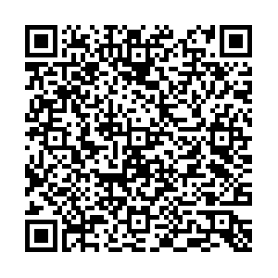
Summary
@ahmedszakaria

